Slide 1
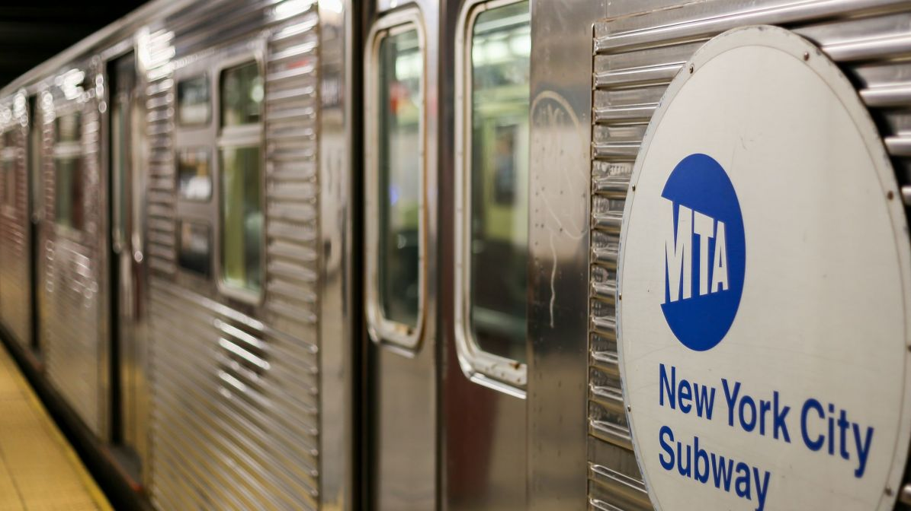
Project Benson
Harmeet Hora
Tarek Barnes
Belle Peng
Irene Liu

Slide 2
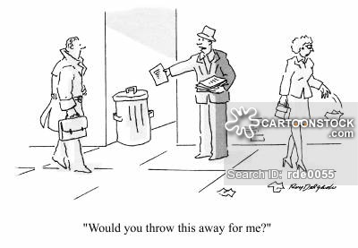

Slide 3
Question
How can we place street teams to maximize the gala’s attendance and contributions?

Slide 4
Goals
Identify holy grail locations
Optimize for attendees & contributions
Elevate the WTWY brand
Increase awareness & reach
Provide opportunity for A/B market testing (reproducibility)
Make future events more successful
Notes:
Holy grail locations = populated & wealthy areas w/ high density of female working professionals.
Brand = Find individuals who are likely to donate and bring friends to the gala.
A/B testing = Create a system for data collection to inform future events

Slide 5



Data
MTA turnstile data
March - May 2018
Yelp data
Restaurants within three miles of the Empire State Building
2010 US Census data
Five year projection for 2015
Notes:
Empire State Building is in the central of most of the popular restaurant

Slide 6
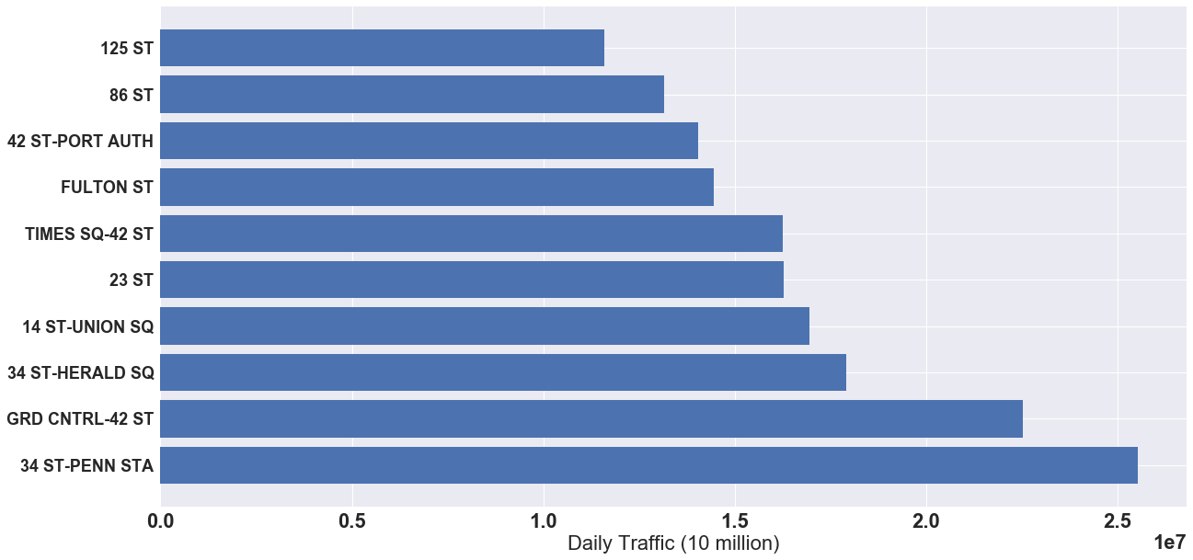

NYC Busiest Subway Stations
11 M
13 M
14 M
14.5 M
16 M
16 M
17 M
18 M
22 M
25 M
Notes:
M = million
Rise the question how do we identify which station should we pick

Slide 7
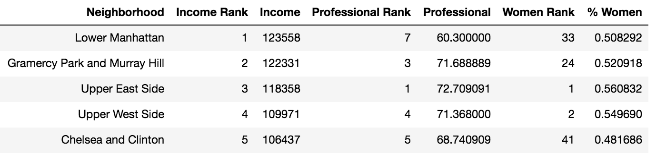

Slide 8
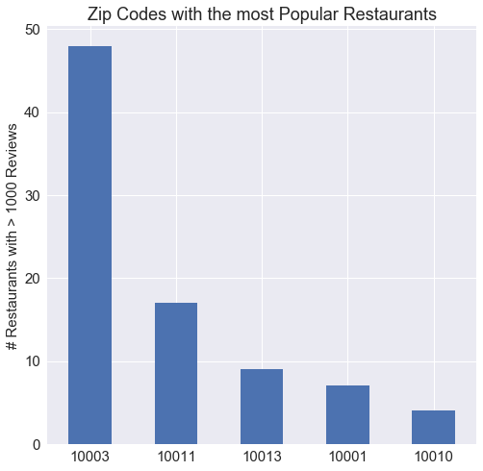
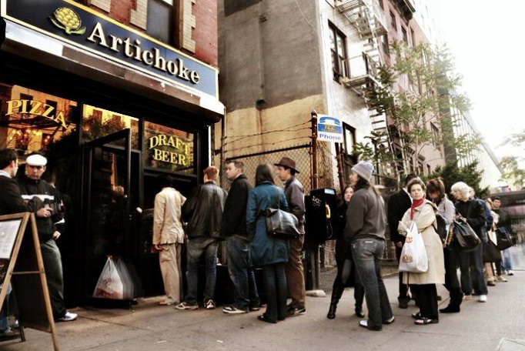
Yelp
10003 Union Sq:
Artichoke Pizza
Momofuku Noodle Bar
Milk Bar East Village
10011 Penn Station:
Cafeteria
Morimoto
Amélie

Slide 9
Recommendations
Identify holy grail locations
34 ST PENN STATION
14 ST UNION SQUARE
86 ST (Upper east side)
Elevate the WTWY brand
Advertise philanthropic motivations for gala
Gather supporters, not just signatures
Create opportunity for A/B market testing (reproducibility)
Place street teams by restaurants & subways
Incentivize bringing +1’s (cap supply of free tickets)
Give website code & ask for email address
Notes:
Holy grail locations =
Brand =
A/B testing =

Slide 10
Thank You!

Slide 11
Future Work
Use google business info to identify the best time for marketing
Combine Yelp data with the review on google map

